Slide 1
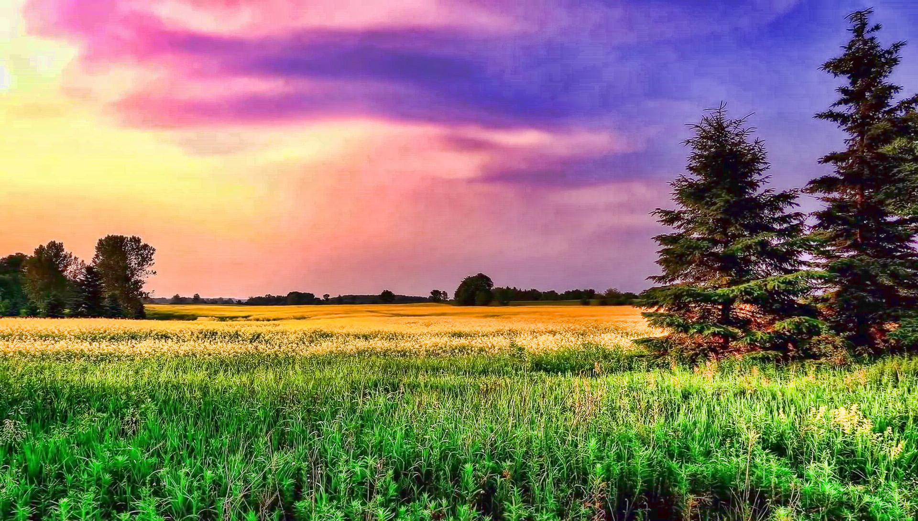
Agricultural-Information-Management-System
Aryan Virdi & Lorenzo Resendez

Slide 2
Actors (Who is this serving?)
Agriculture relies on a complex network of factors, including soil!
Soil information is necessary for agricultural operations
Maintenance is necessary for both soil and crops
Local agricultural histories inform future crops.
Farmers work with agronomists to optimize their yields and maintain their fields.

Slide 3
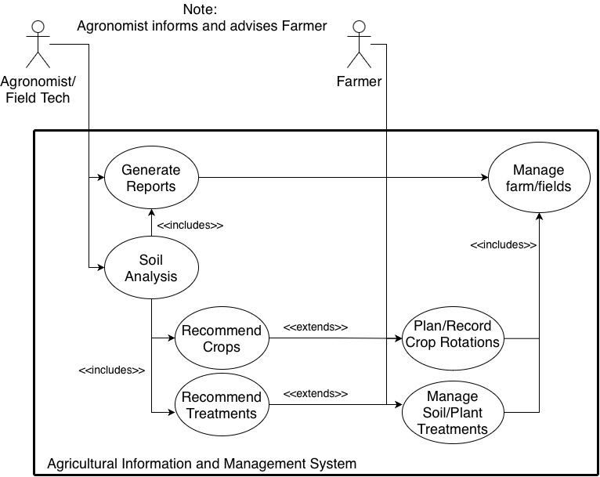
Use cases

Slide 4
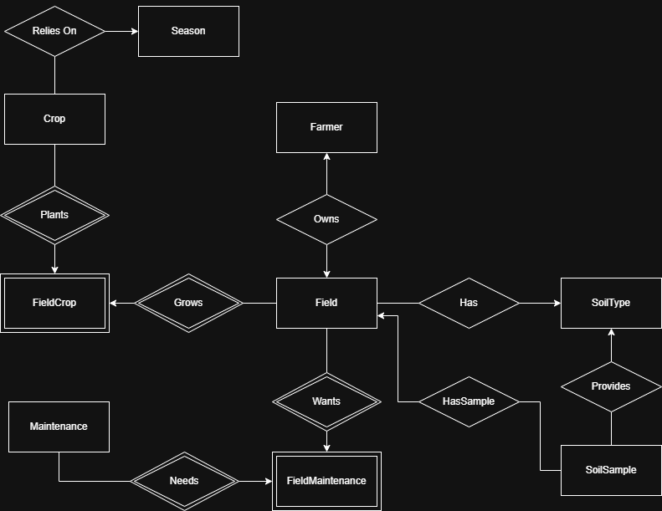
E/R Diagram

Slide 5
Relational Schema I
Farmer(FarmerID, FieldID, FirstName, LastName)
Field(FieldID, FarmerID, SoilTypeID)
SoilType(SoilTypeID, AvgSand, AvgSilt, AvgClay)
SoilSample(SoilSampleID, FieldID, DateCollected, SandPct, SiltPct, ClayPct,
pHValue, N_ppm, P_ppm, K_ppm, organicPct, CEC, Contaminants)
Crop(CropID, Name, SciName, daysToMature, preferredSeason, preferred_pH
GermRate, WaterUse, NutrientUse)
Season(SeasonID, SeasonName, StartDate, EndDate)
Maintenance(MaintenanceID, Category, ApplicationDate, ActiveIngredient, Notes)

Slide 6
Relational Schema II (Many-Many)
FieldCrop(FieldID, CropID, seasonID, beginDate, endDate, yield)
FieldMaintenance(FieldID, MaintenanceID, ApplicationDate,
EndDate, Amount, Concentration)

Slide 7
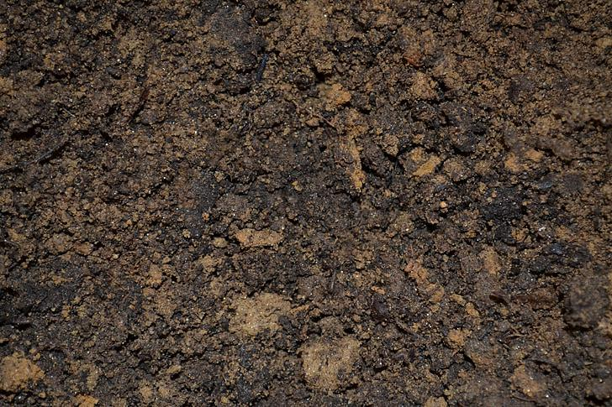
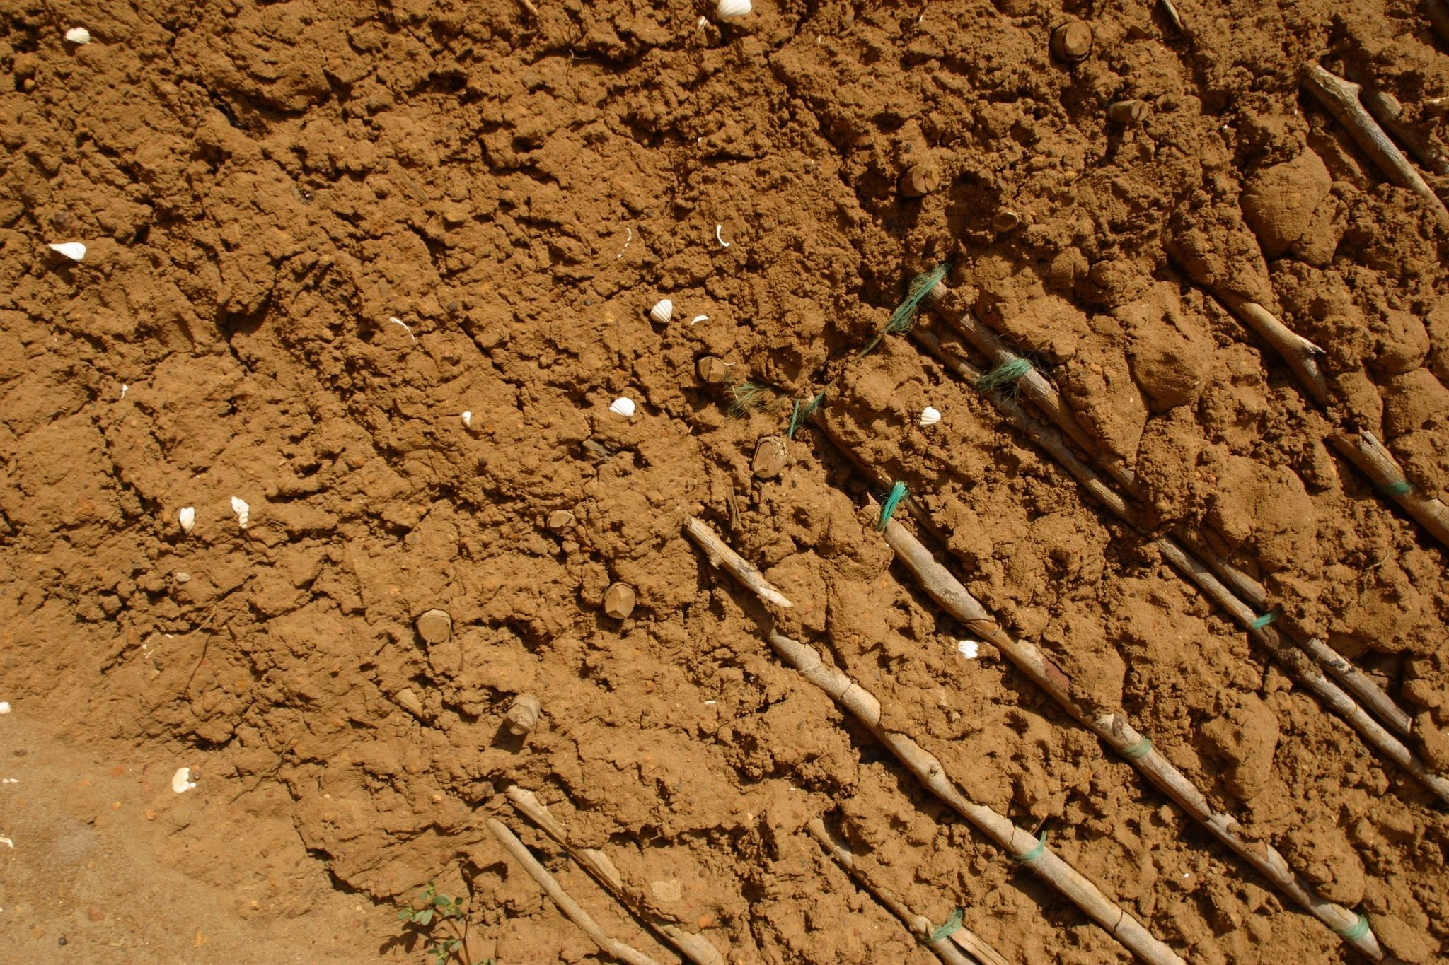
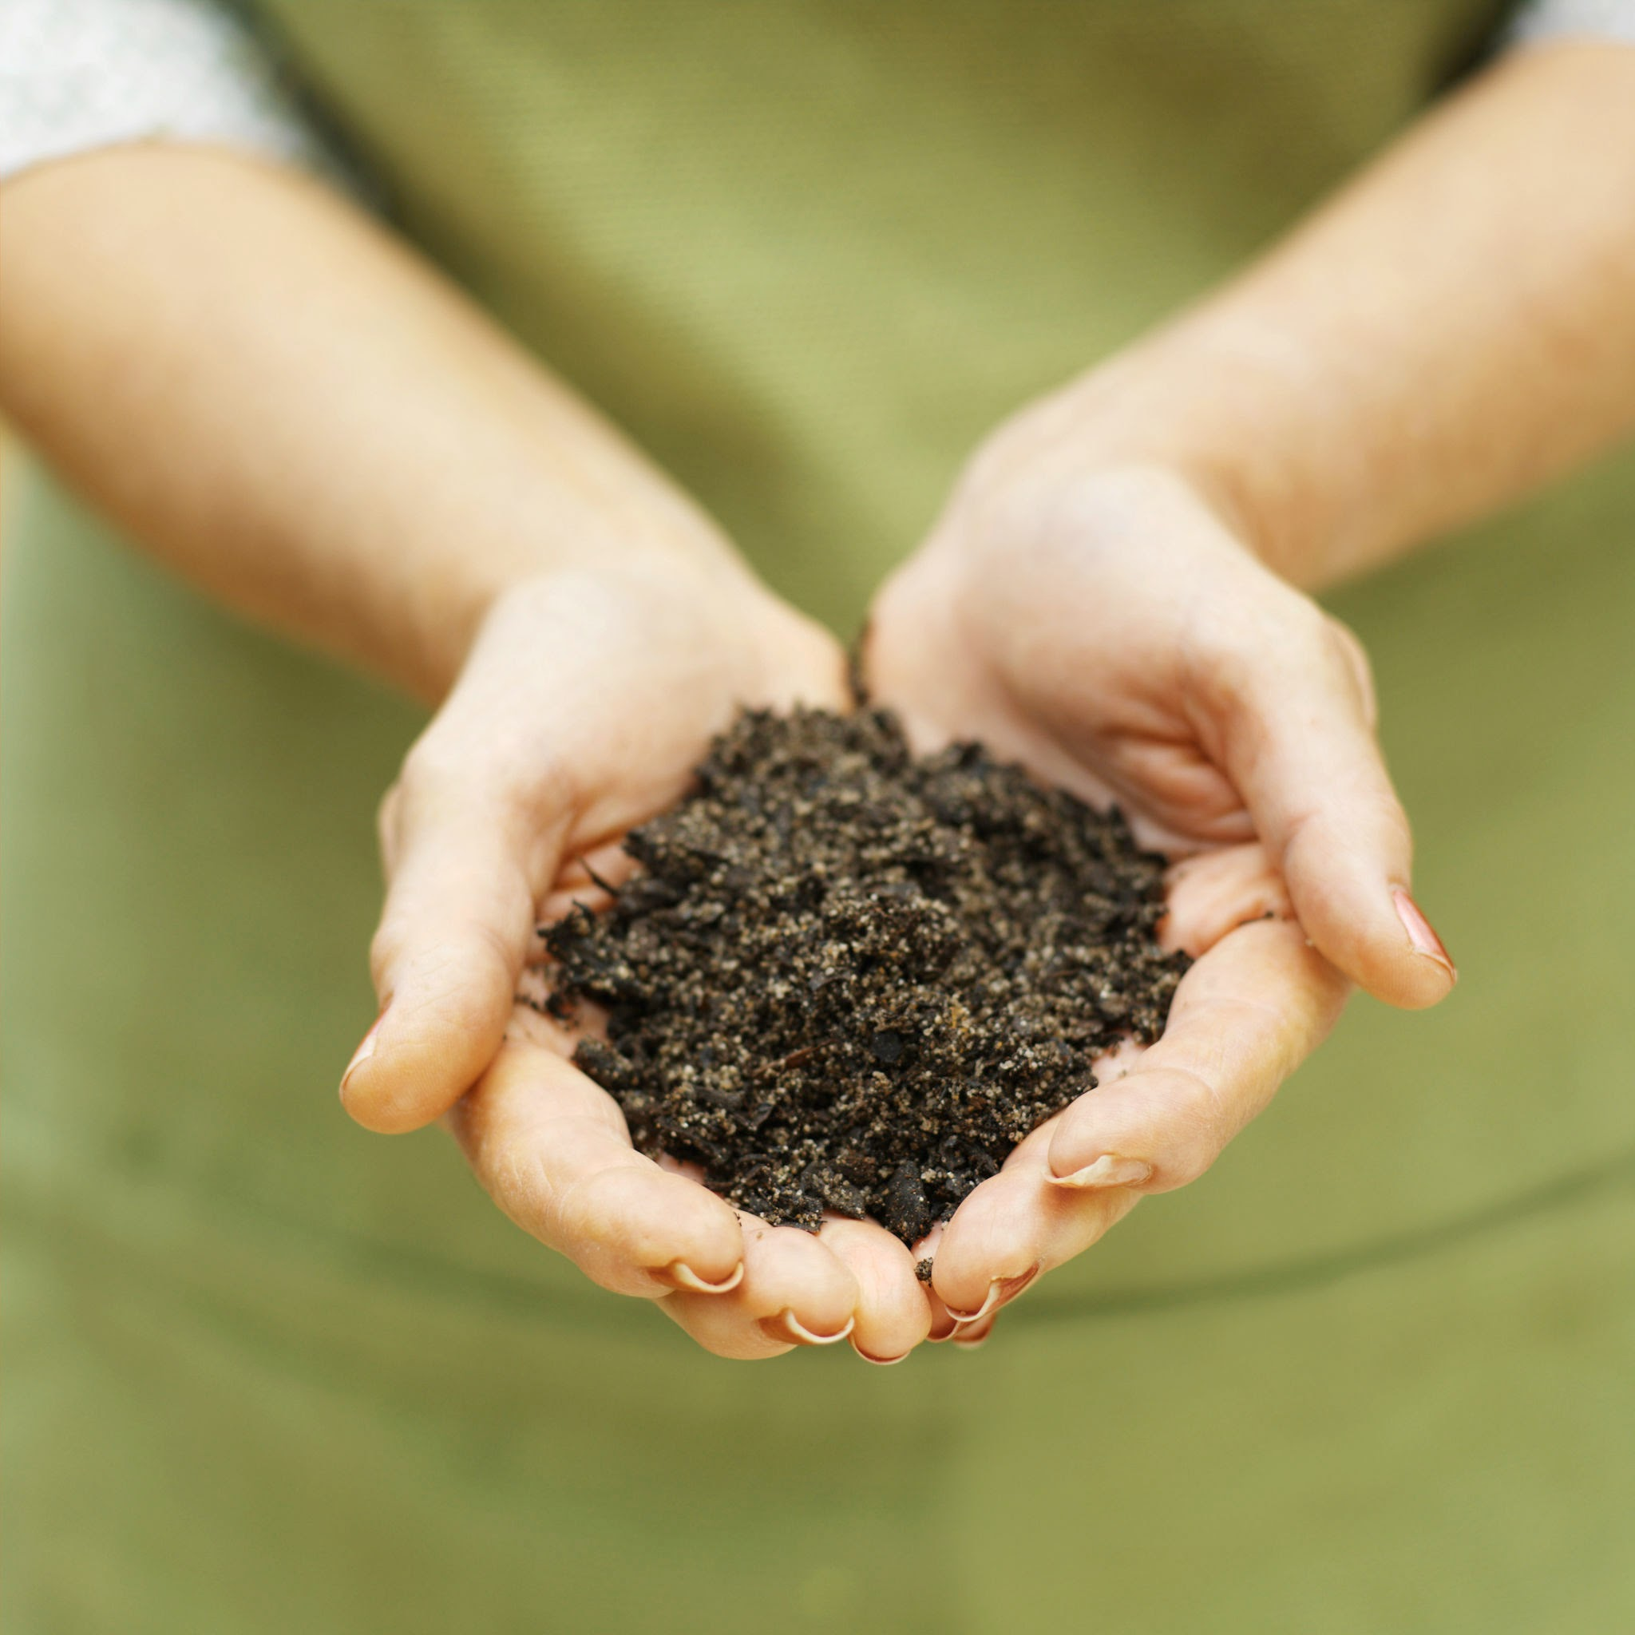
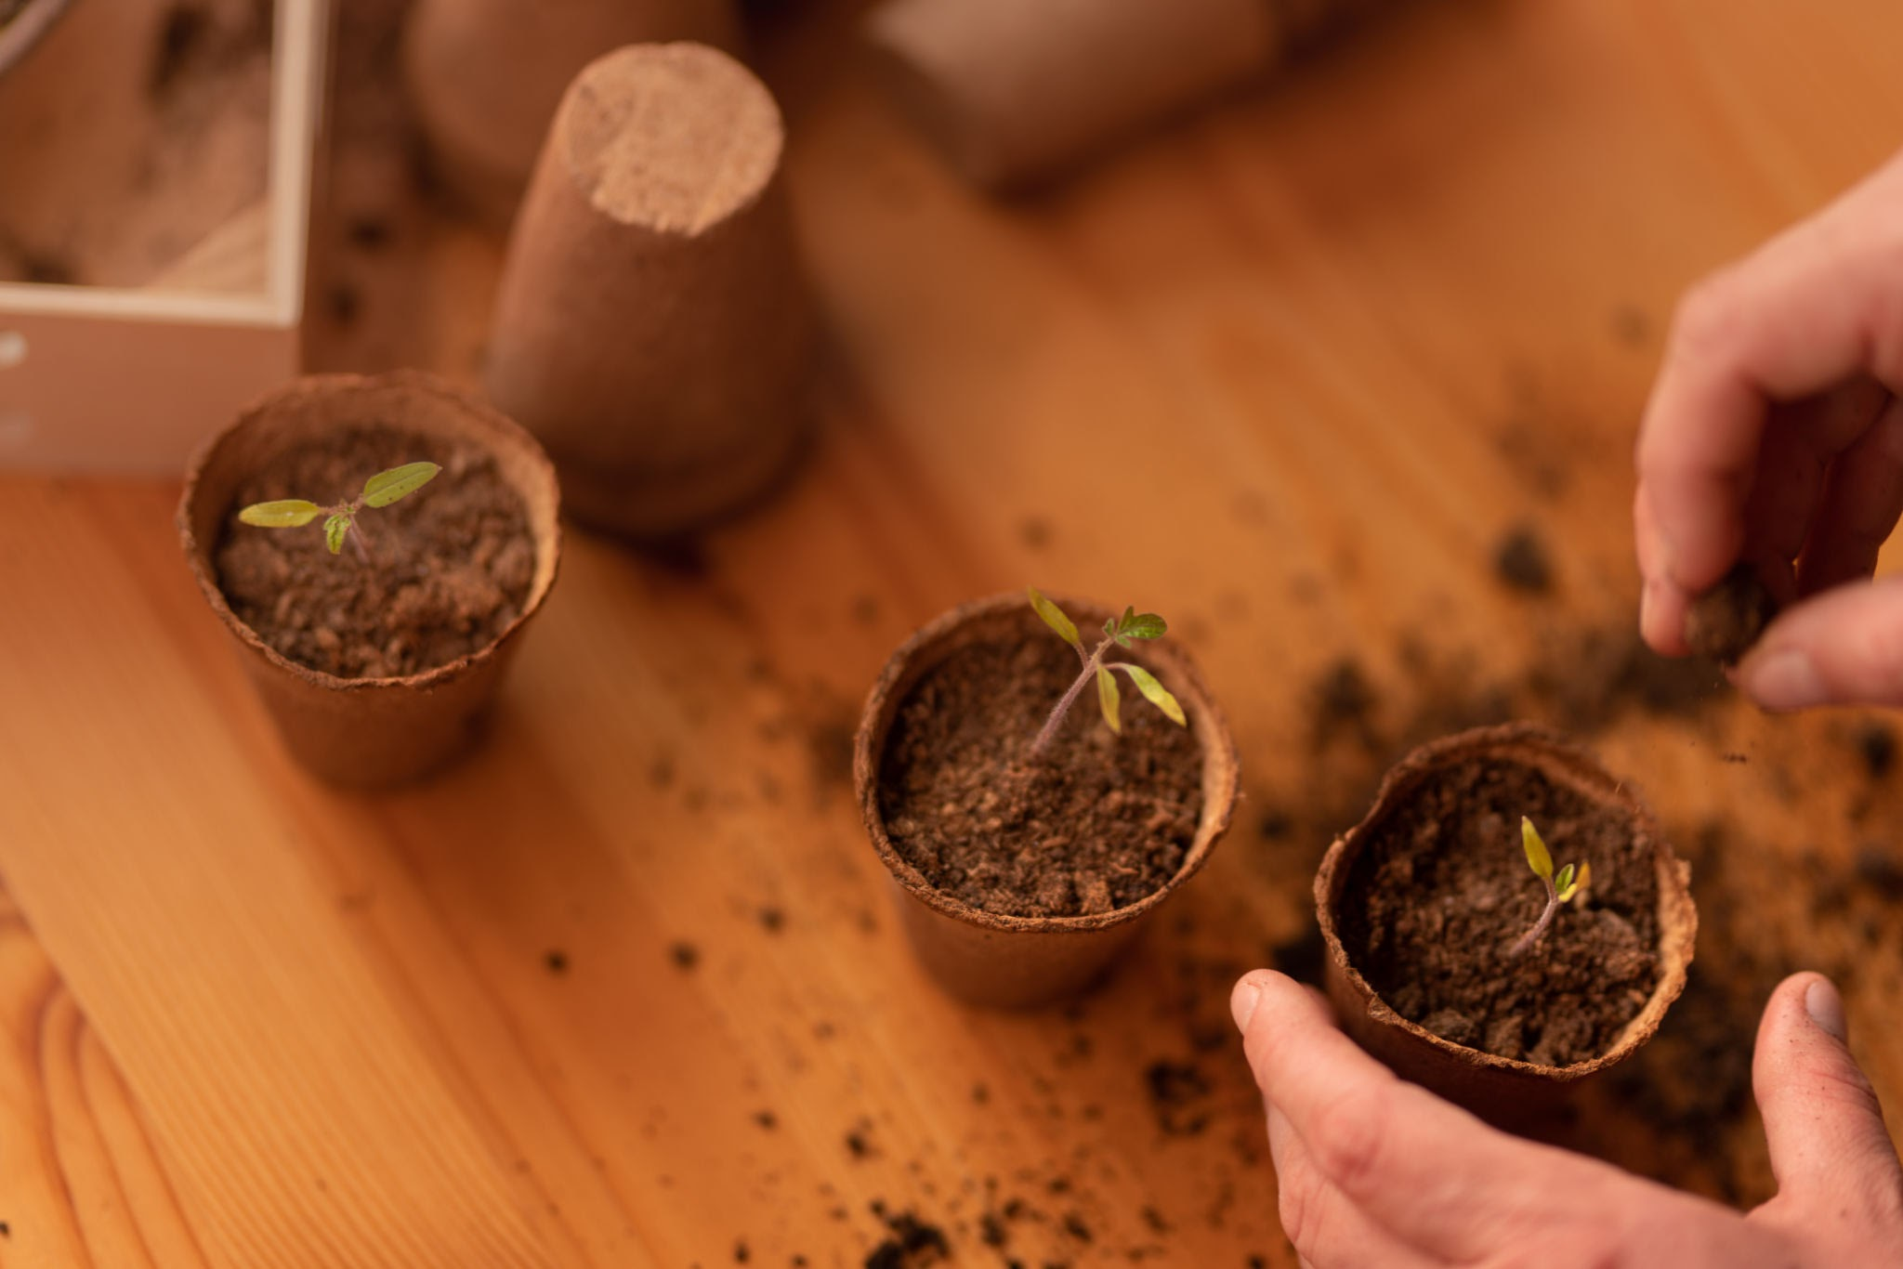
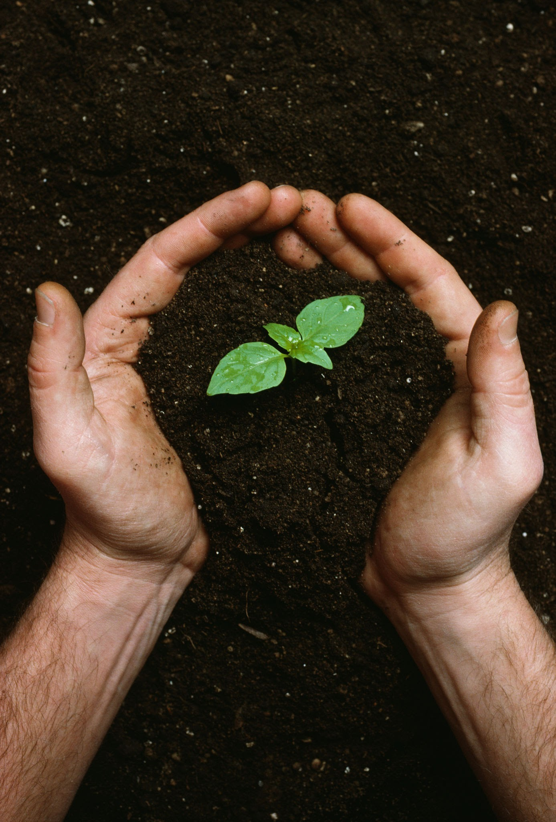
A.I.M.S
A database for agricultural optimization.

